Slide 1
Tools and Projects
Portfolio
Farraen Mohd Azmin
Jan 2025

Slide 2

Farraen Mohd Azmin
Current Responsibilities:
Develop innovative battery solutions and model optimisation
Previous Responsibilities:
Lead AI/ML projects
Develop tools to solve automotive problems
Software owner of ECU Parameter Optimiser (MPT) and Trace
Project Highlights at Ricardo:
Decision engine for eMachine generative design
Prognostics for predictive maintenance
Vehicle digital twin development
ECU subsystem optimisation
Automotive controller Optimisation
Ricardo Trace project (ECU strategy development project)
Dynamic model algorithm development for two-stage calibration
Big Data project for engine component prognostics
Connected BMS and smart-scheduling algorithm development
SCC Cloud project (Ricardo Parameter Optimiser)
Technical Specialist, Machine Learning and Model Optimisation
Elysia (Battery Intelligence), Fortescue Zero

Slide 3
Engine Development Engineer in Calibration and Advance Testing group
(Proton Malaysia)
Automotive Engineering Student
2004
2008
Research Assistant at LU
PhD student in controls group at LU
Project Engineer
Software, Controls and Calibration
(Ricardo)
2015
2014
2012
2016
2018
2022
2023
2024
Awarded
PhD by LU
Senior Project Engineer,
Machine Learning
Software, Controls and Calibration
(Ricardo)
Technical Specialist, Machine Learning
Software, Controls and Calibration
(Ricardo)
Technical Specialist, Machine Learning
Software and Digital Engineering
(Ricardo)
Technical Specialist, ML and Model Optimisation
Elysia
(Fortescue Zero)

Slide 4
R-Drive
A graphical user interface (GUI) based tool that extracts acceleration data from vehicle recordings and converts them into an acceleration map. This tool can reduce the time required for manual processing from two weeks to just five minutes
R-Machine
A Machine Learning toolset including custom regression tool and PSO optimisation.
Strategy Compare Tool
Developed tool for comparing Bosch strategy document diagrams
ML Model in Excel VBA
A function was created to convert Ricardo ML model (SPM) into VBA BAS modules. The function enables running ML predictions within Excel without the need for Matlab or any other software. function to convert Ricardo ML model (SPM) into VBA BAS modules and run ML predictions within Excel without Matlab or any other software
MDF Tool
MDF file read, write and data alignment tool
Software and Tool highlights
MPT
Simulink optimisation tool for calibration and control engineers
Graph Trace
The tool is capable of digitalizing contour plots or map images. It can convert a contour plot in just 2 minutes, which would otherwise take a day to convert manually.
Performance Test Report Generation
A VBA script to extract dyno performance test results and compile it into a report
Trace
Image to Simulink model digitalisation tool. The tool can convert models in minutes.
MPT
Simulink optimisation tool for calibration and control engineers

Slide 5
Simulink Optimisation
Developed a tool called MPT to optimise maps for controller and strategies
Optimisation
Experienced in optimisation for various engineering problems including map smoothing, controller optimisation, etc.
Testbed
Have experienced in operating AVL bobcat and Froude Cosine testbed in the past (more than 8 years ago)
Software development
Matlab and Python scripting
Matlab-based software full development and SW release
MVC and HMVC framework
Experience in dashboard (Dash) and JavaScript
Experienced in preparing pipeline and yml file for deploying scripts from VSCode to Gitlab CI/CD and finally to Kubernetes
Simulink Problem Solver
Supported calibration and control engineers to solve complex Simulink problems
Simulink Strategy Development
From PDF to Simulink model
Cloud Computing
Experienced in AWS SageMaker, Lambda and API gateway to do real-time inference for vehicle measurements
Work Experiences
Simulink Compilation
Experienced in compiling Simulink models to DLLs and FMUs
Image Processing
Experienced in converting images into data
Developed tool for converting images of maps and contour plots into numeric data
Object and line detection algorithms
Calibration
Worked a three years at engine test cell calibrating base engine maps
Converted 16-bit ECU to 32-Bit ECU
Calibrated a rotary engine at test cell from empty maps
Installed Motec racing to a research vehicle and prepared short harness
Machine Learning
Developed ML regression algorithm from scratch
Experienced in many various of ML models including neural networks, deep neural networks and reinforcement learning
Experienced in predictive maintenance
Data Generation
Used Monte-Carlo Simulation to develop artificial fleet data
Used damage model for a fuel system to develop realistic fleet data
Simulink in XPC
Embedded a Simulink model that can optimise engine maps in real-time in xPC for PhD research

Slide 6
Matlab toolboxes
Reinforcement
Learning
PyCharm
Spyder
Sklearn
GitLab CI/CD
AWS SageMaker
Kubernetes
VSCode
Keras
Jupyter
Docker
Machine Learning
IDE and Env
Azure (Basic)
Python
VBA
Deployment
AWS
Cloud
Programming
Language
AWS Lambda
Matlab
Simulink
Skills
Dashboarding
Dash Plotly
S-function
Model
JavaScript
FMU
Version control
Database
GitLab
Gradient (fmincon)
Model-based
Optimisation
Plastic SCM
DoE
Ricardo Efficient Calibration
Genetic Algorithm
Basic SQL scripting
Hybrid Optimidation
Statistical Model
ETAS ASCMO
PSO
Mathworks MBC

Slide 7
PhD
Title: Algorithms and Architectures
for Self-calibration of Engines

Slide 8
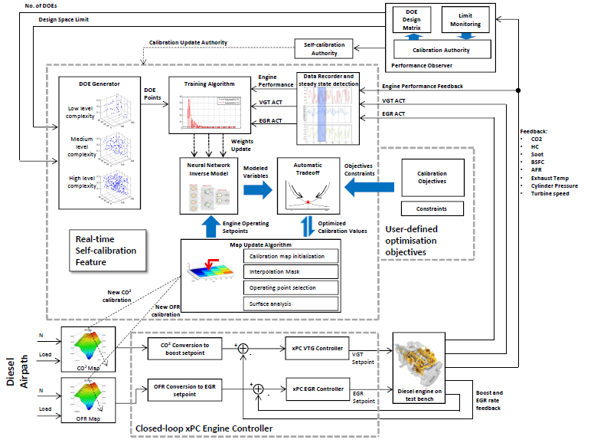
The project aims to reduce calibration effort by automating a model-based calibration process.
The platform is capable of automatically running an engine, modeling the engine responses, and performing live optimization while the engine is being operated. The primary motivation behind the project is to assist calibration engineers in reducing the repetitive process involved in calibration development.
The platform was developed using Simulink s-functions and integrated into an xPC target machine for actual engine testing. Everything, including the machine learning model and optimization algorithm, was written from scratch to reduce dependency on many toolboxes.

Slide 9
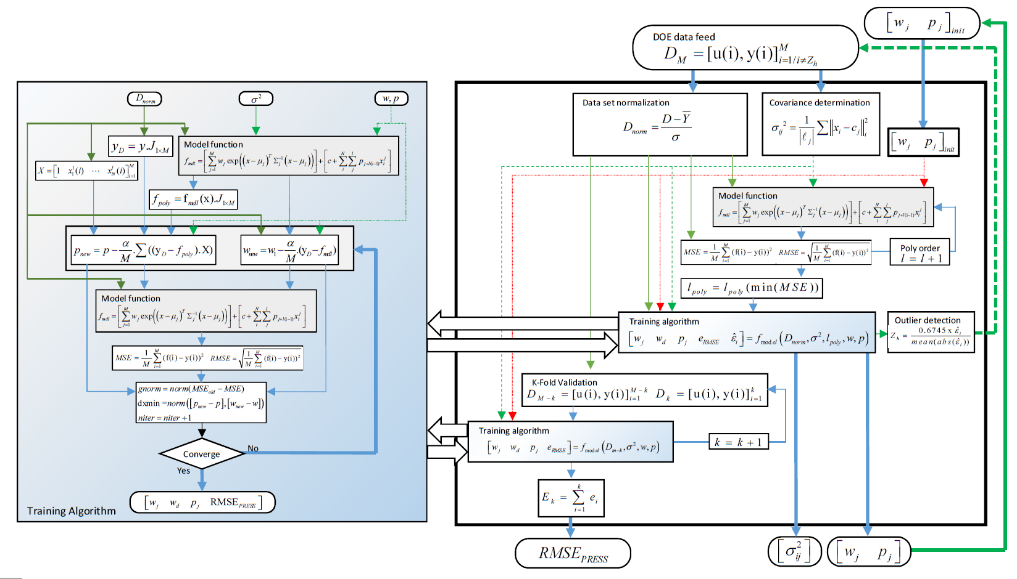
Static model algorithm and its training process are custom developed for a fast learning process. The diagram shows the developed hybrid radial basis function(RBF) neural network model framework and gaussian process training algorithm.
The ML model was developed from scratch and is structured in a way that can support constructive modelling and can run fast in a Simulink model.
It can learn new engine data and predictions in real-time while the engine is being operated.

Slide 10
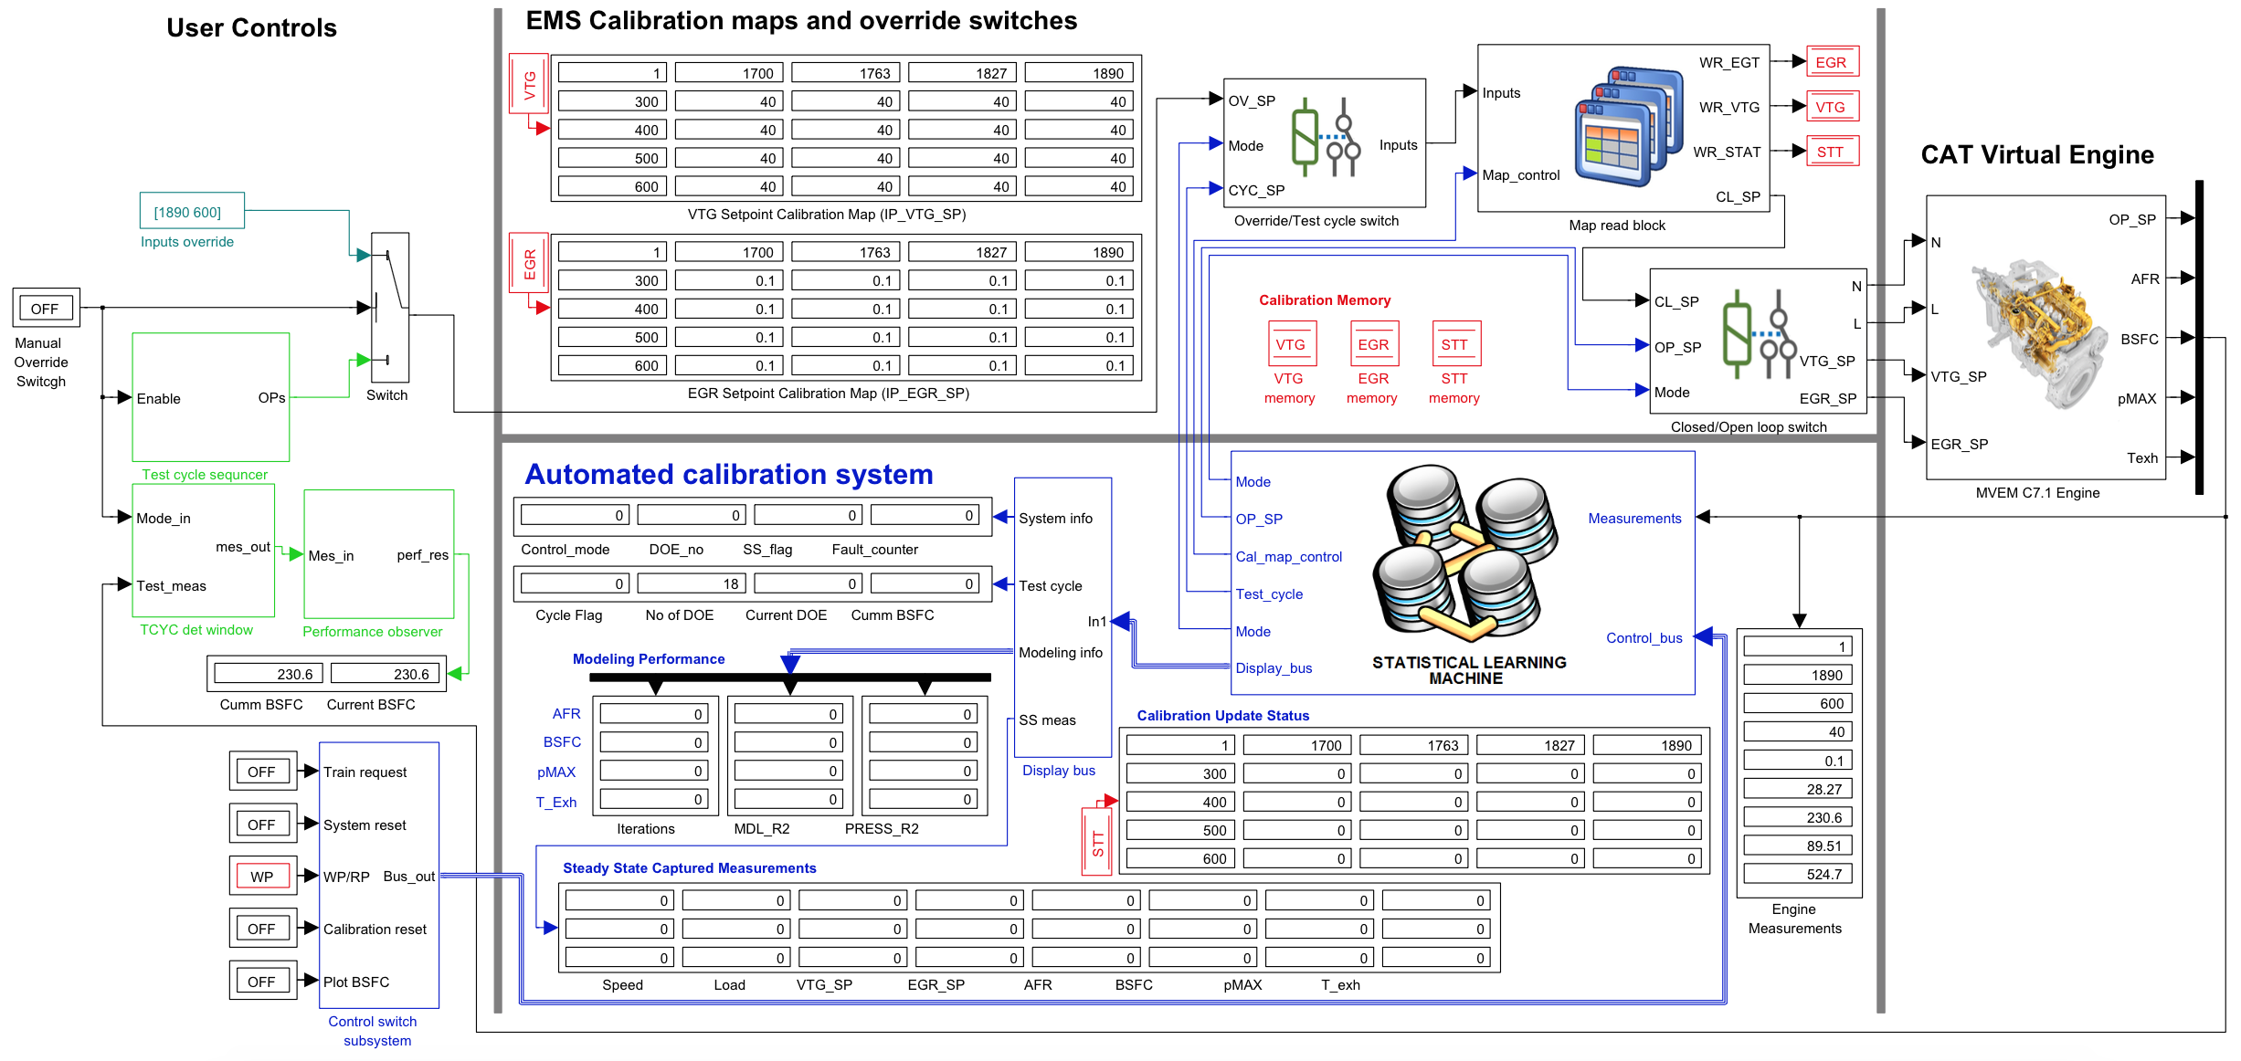
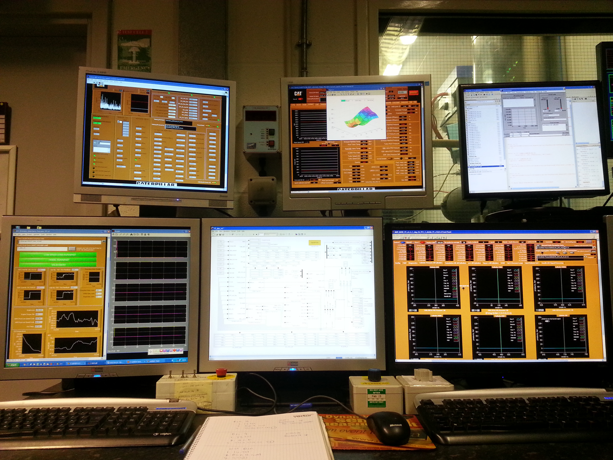
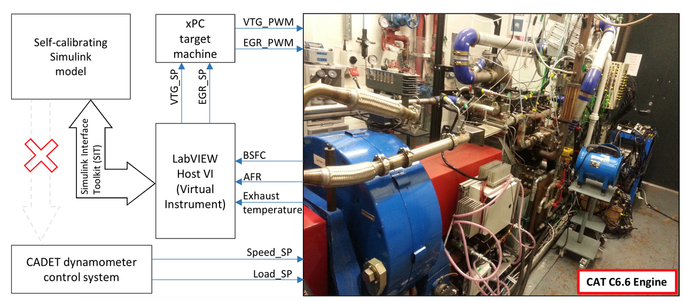
The platform is capable of controlling an actual engine using an xPC target machine. It has been tested on a diesel engine and has successfully calibrated its VTG and EGR set point maps. The Simulink system developed can take over an engine and run an automated calibration process in real-time. A picture of the actual Simulink system is shown below:

Slide 11
screencast.png

Slide 12
Calibration Optimisation
Projects and Products

Slide 13
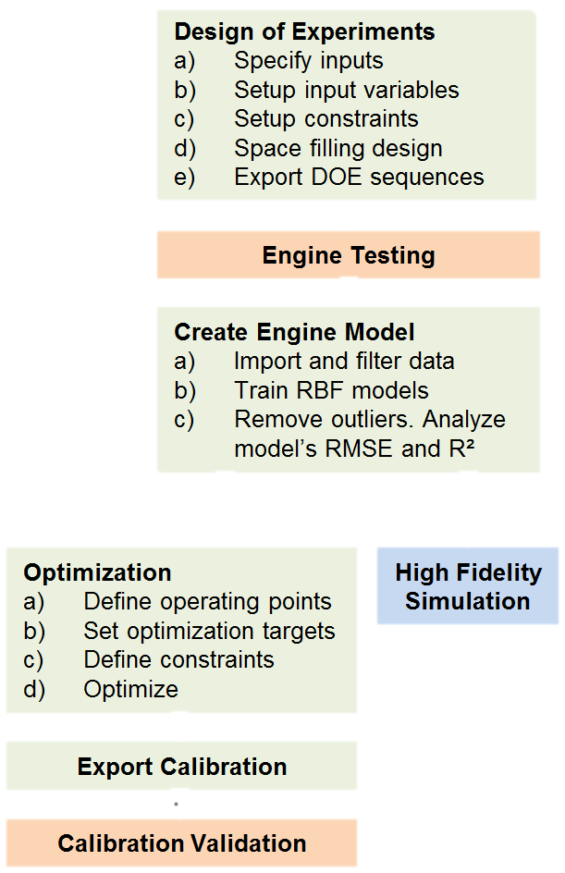
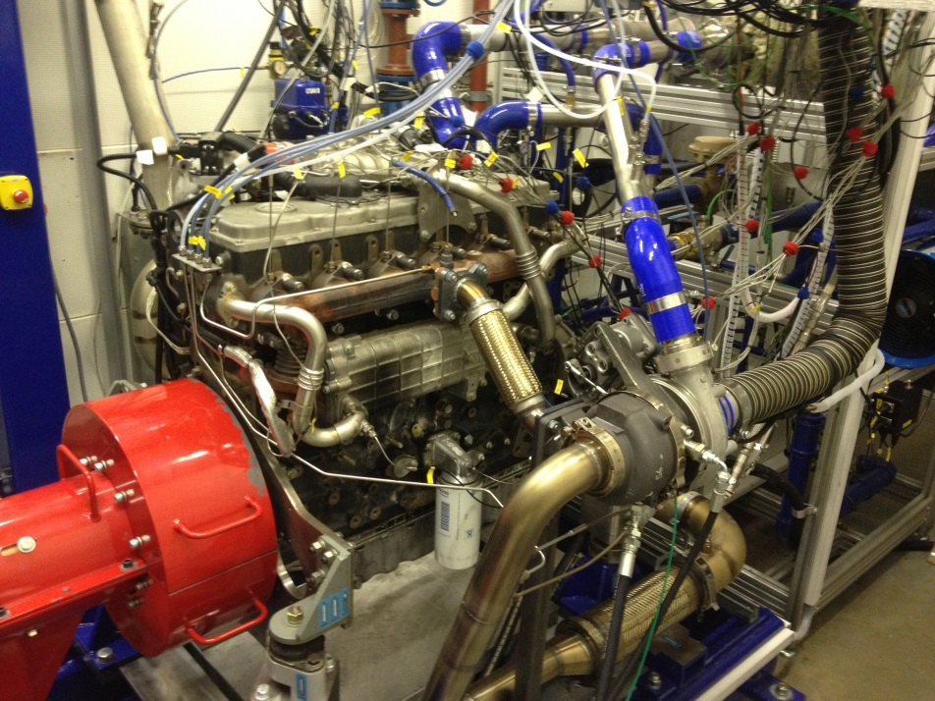
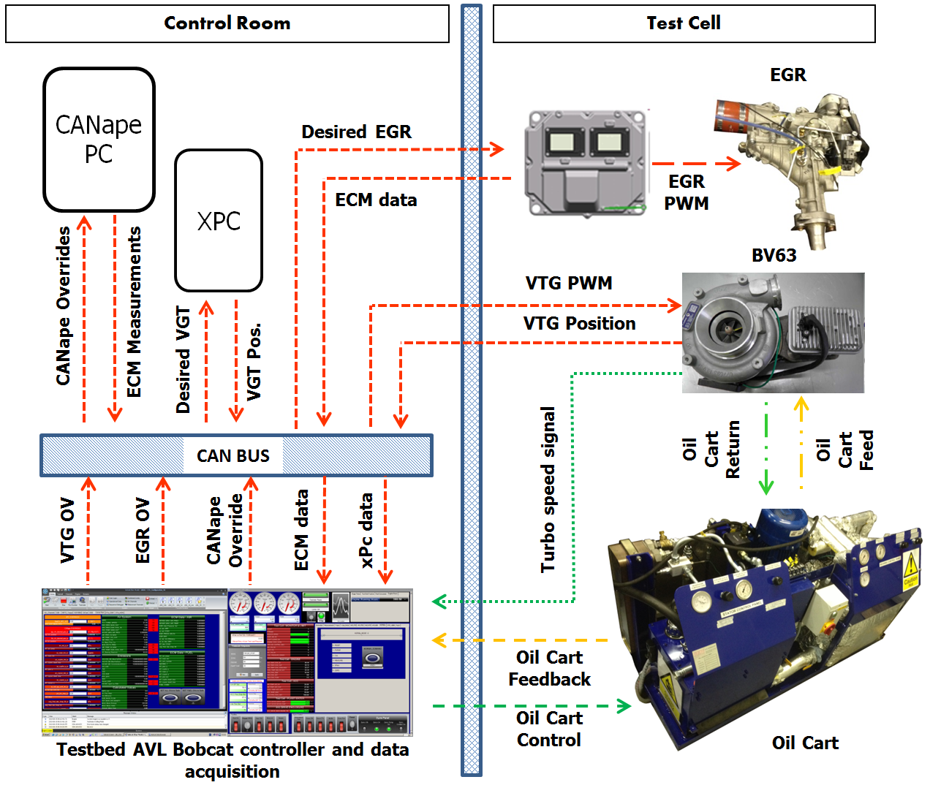
A Loughborough University project with Caterpillar, sponsored by TSB and ETAS as the supplier of optimisation tool
The calibration process uses a Cat® C7.1 ACERT™ industrial engine and the VGT and EGR setpoints maps need to be recalibrated before ETA (Electric Turbo Charger) installed
My role is to operate the AVL bobcat test cell, design operating points, model the engine responses and generate the calibration maps
Used a Model-based Calibration (MBC) approach to generate the calibration maps
using ETAS ASCMO

Slide 14
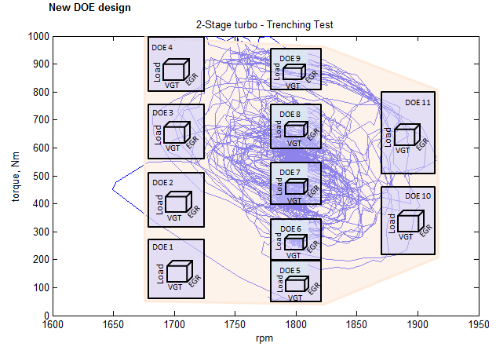
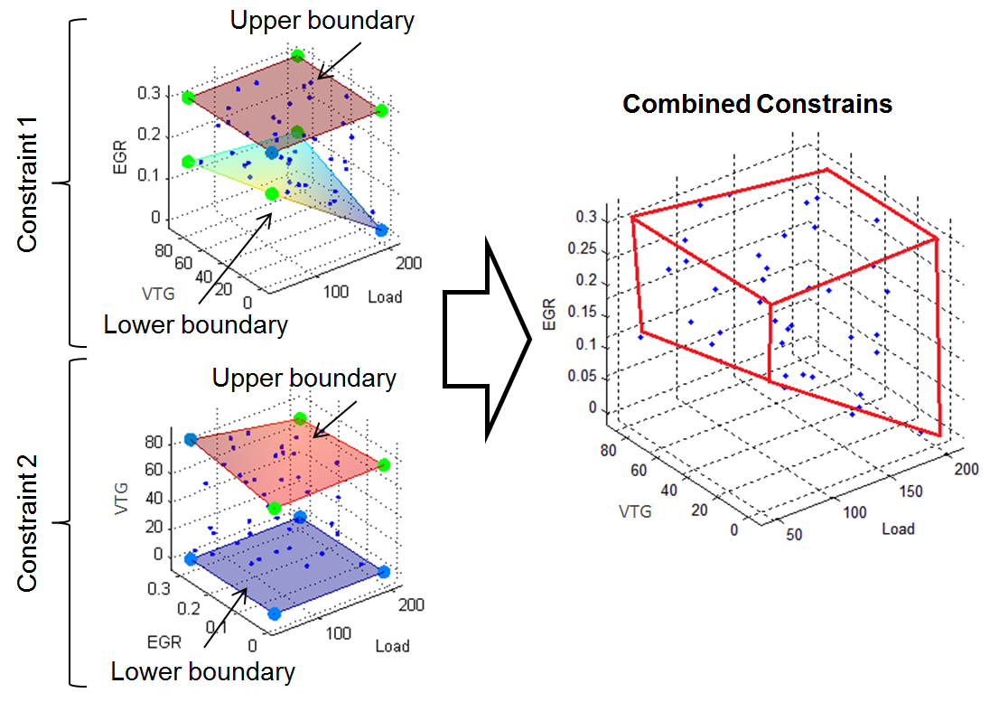
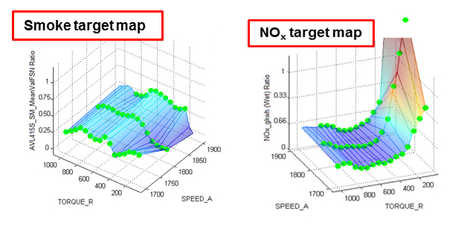
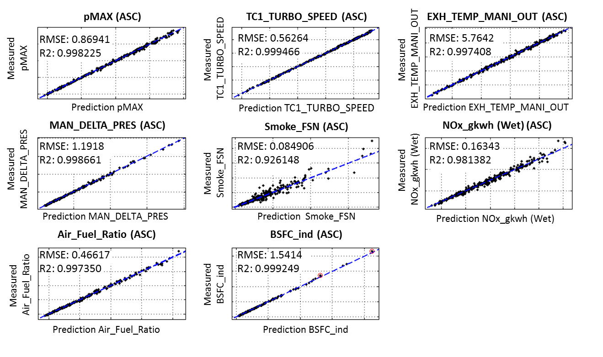
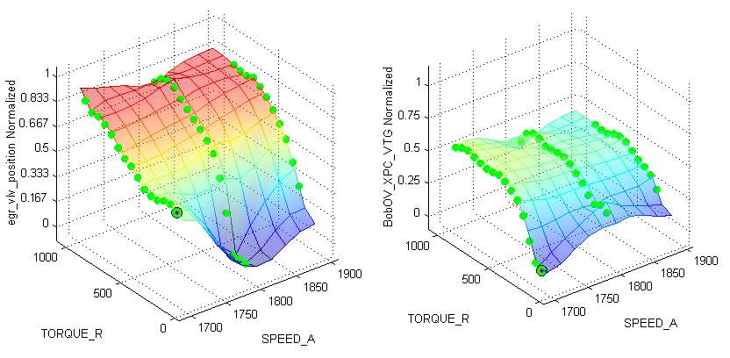
Design of Experiments
The design is split into 11 DoE designs (Sobol Sequence) due to the complex system behaviour
4. Optimisation objectives
Minimize BSFC
Match NO_{x} to 2 stage configuration
Smoke ≤ than 2 stage
Engine mechanical ≤ limits
3. Engine modelling using Gaussian process
2. Data collection at test bed
5. Optimised VGT and EGR setpoints

Slide 15
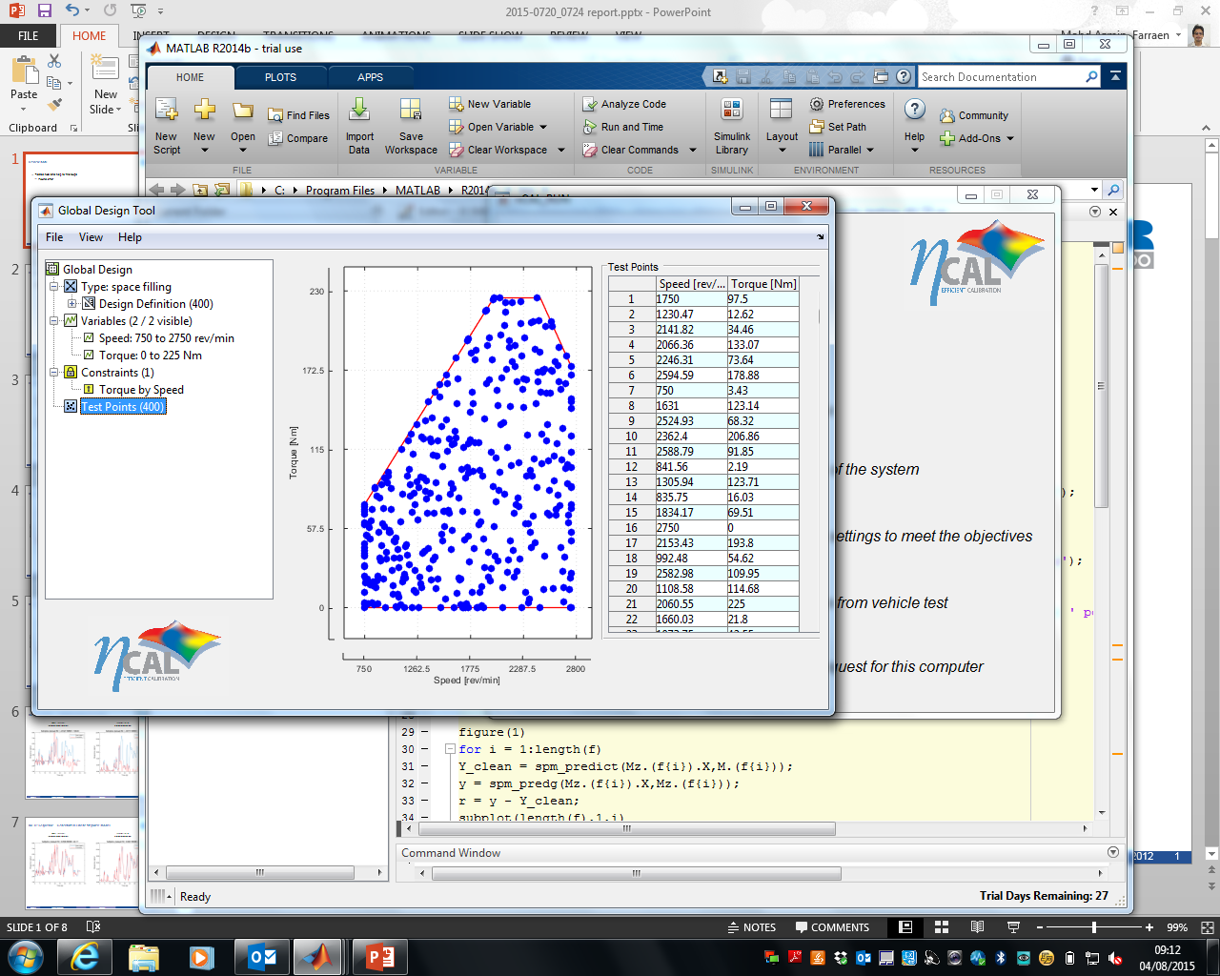
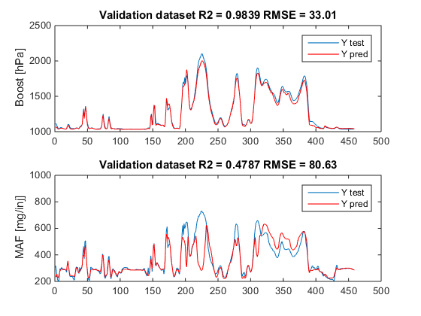
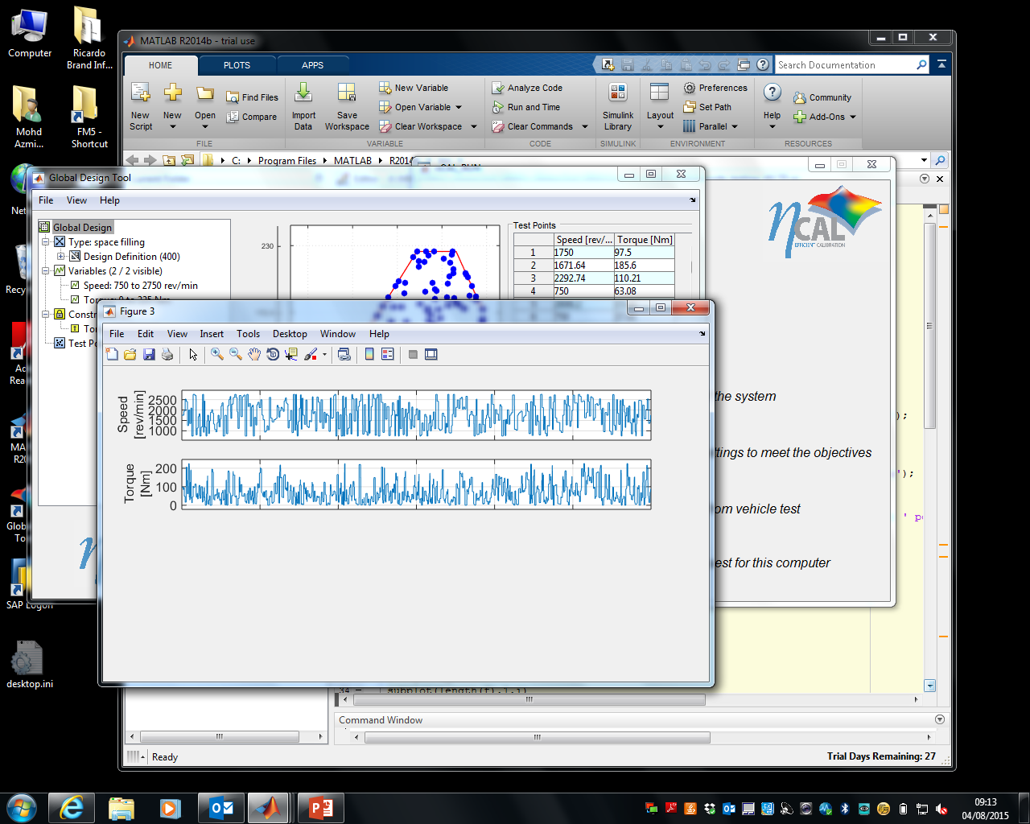
Experienced in developing time-series DoE setpoints for a two-stage calibration project
Created hot and cold test DoE sequence
Copied constraints from a previous project and created new sequence using APBRS (dynamic)
The engine test results are then used to create air system models which can predict boost and air mass flow for the model-based calibration process
Used the DoE data to train a NARX model for predicting air system responses
Ricardo model-based calibration tool
Engine Testing at test cell

Slide 16
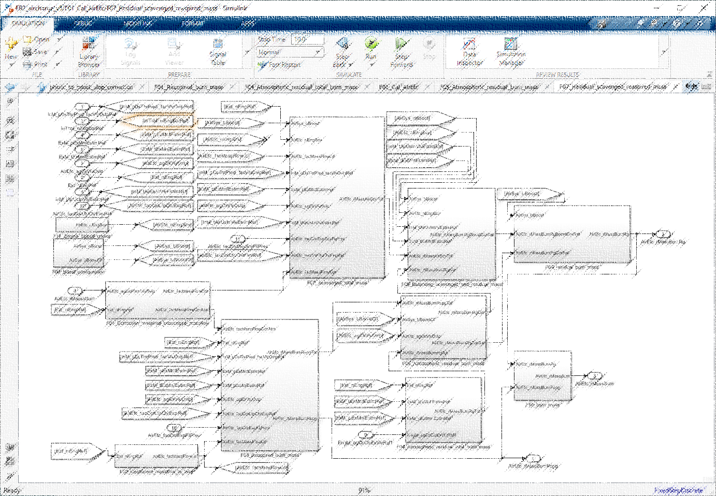
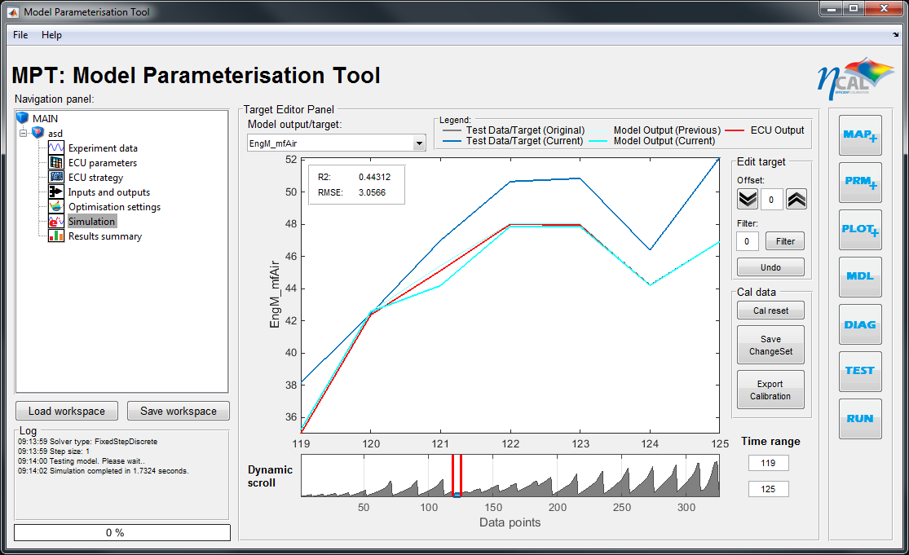
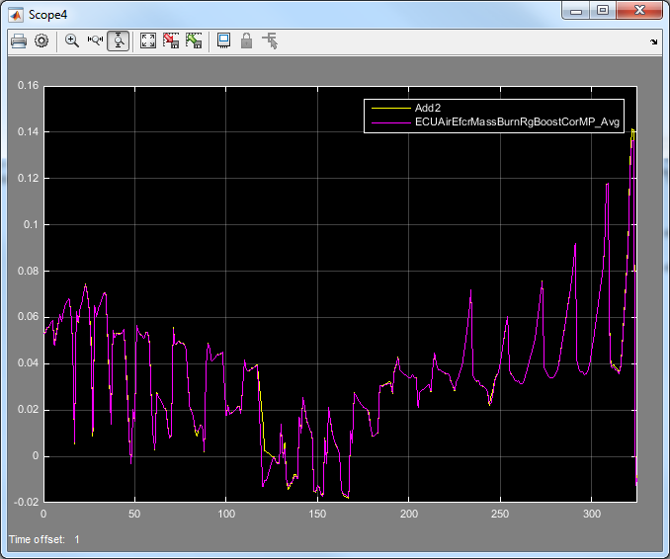
A project for a European automotive manufacturer to optimise their ECU as a part of vehicle development
My task was to recreate the Simulink model based on an ECU documentation and optimise the calibration maps
Using my optimiser tool called MPT (Model Parameterisation Tool), the air system maps are optimised to match a measured value (sensor values)
The optimised maps are stored in a DCM file and sent back to the client for validation
Client’s Airpath Control Strategy Document
Calibration map optimisation
* Image blurred due to project confidentiality

Slide 17
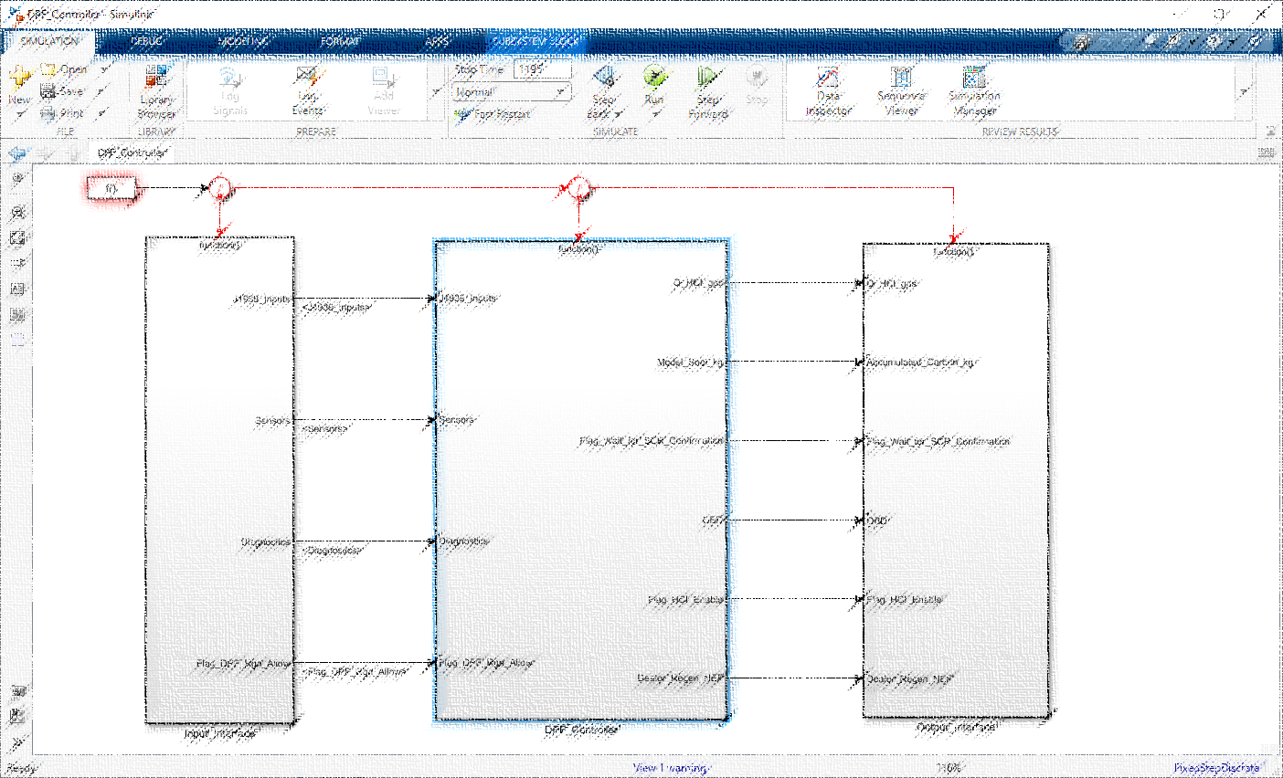
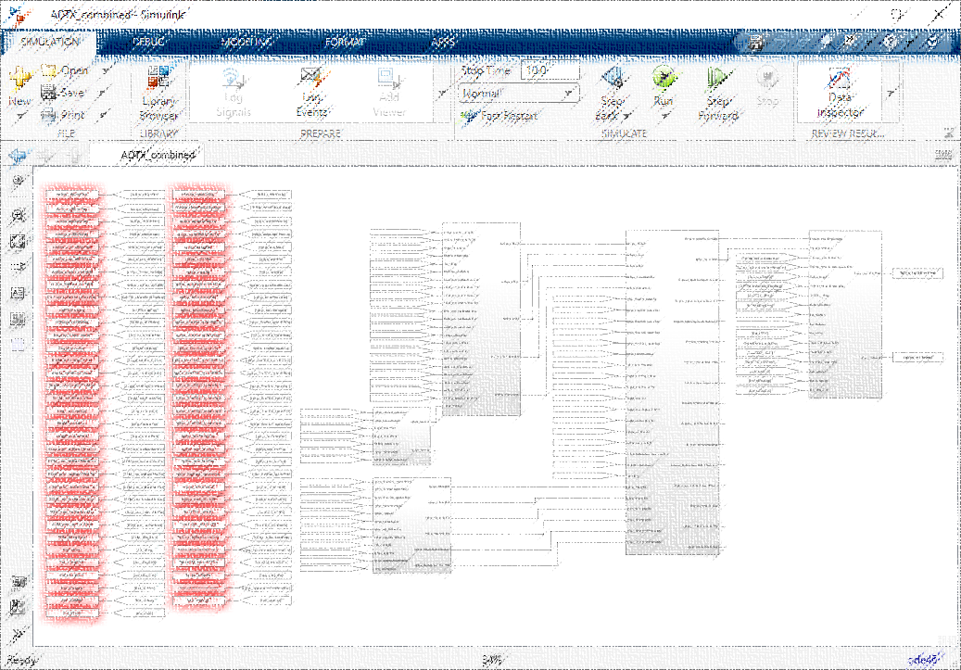
Supported calibration engineers to recreate subsystems for control strategies and use it in MPT
Troubleshoot common problems in Simulink such as:
Subsystem with different rasters
GoTo and FromTo are not assigned properly
Unknown blocks
Algebraic loop not properly handled
DPF Controller
* Image blurred due to project confidentiality
ADTX Torque model
* Image blurred due to project confidentiality

Slide 18

Supported vehicle calibration development project for a UK-based automotive manufacturer
Operated Tsim, an exhaust temperature model simulator from the ECU supplier
Tasks:
Check modelled exhaust gas temp is matching to the measured values
Make adjustments to exhaust temperature maps when needed
Dew point end reporting and checking pass criteria
Reporting
Vehicle Recording (dat files)
Exhaust temperature model
TSIM
Calibration file
(DCM)
Dew point end

Slide 19
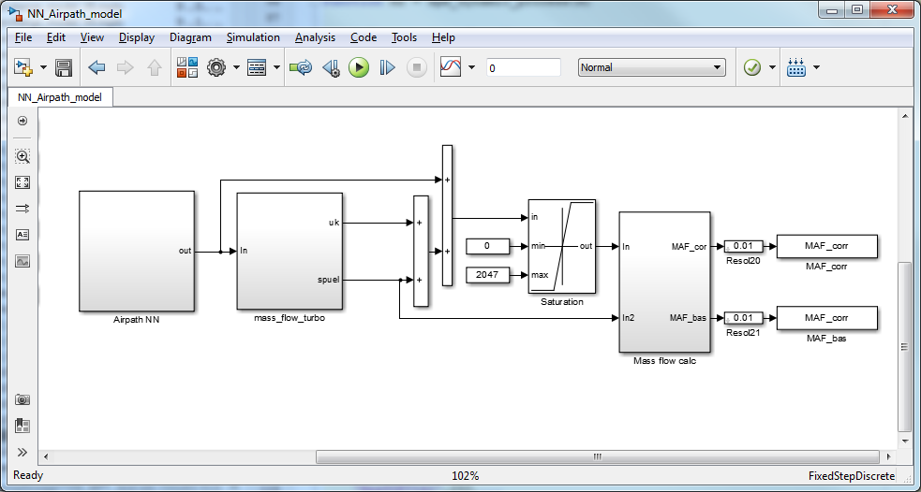
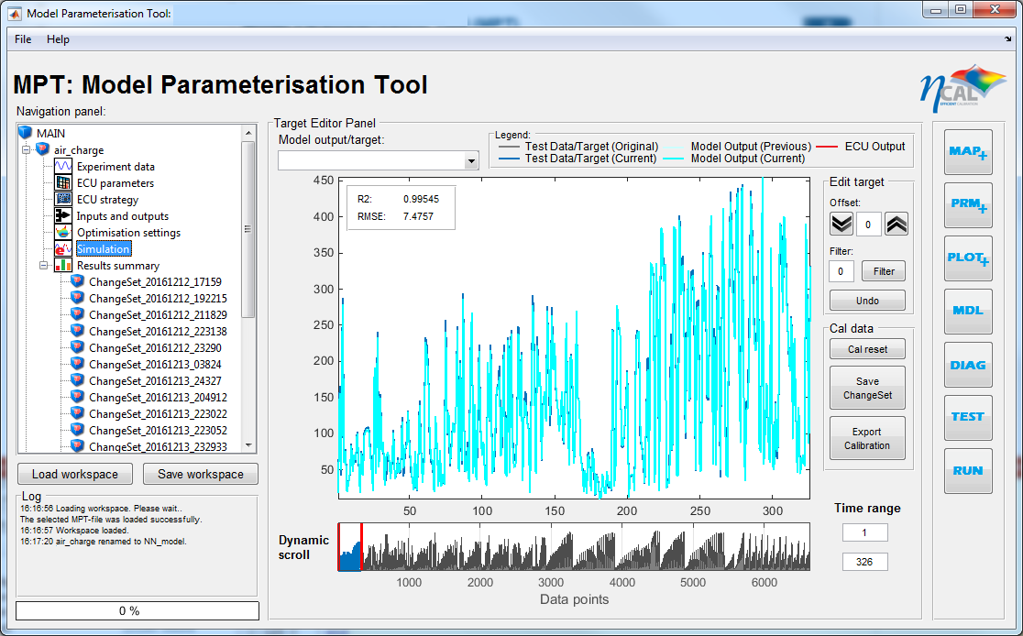
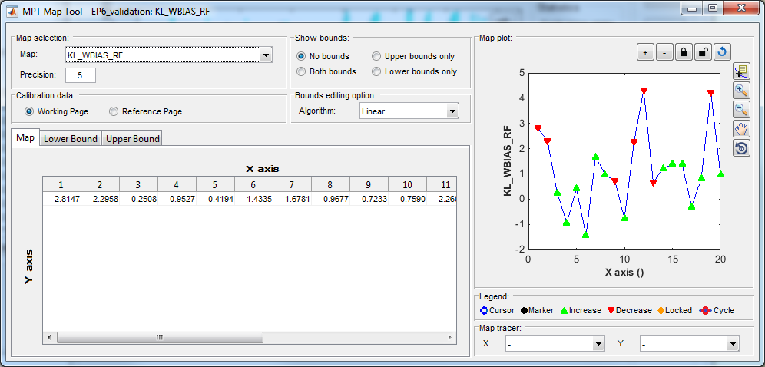
Calibrated a complex neural network air path system and produced a set of maps with high model accuracy
Combine the EMS air charge model (MiL) with DoE test data to populate the air charge model through a series of structured steps
Weights and biases of the network are calibrated instead of maps or constants
A significant improvement over the previous calibration
More than 95% of data points met the set target
Airpath using neural network
MPT V2 adapted to optimise neural network
Model performance
Model error with supplier maps
Model error with MPT Optimised maps
One of the optimised neuron bias maps

Slide 20
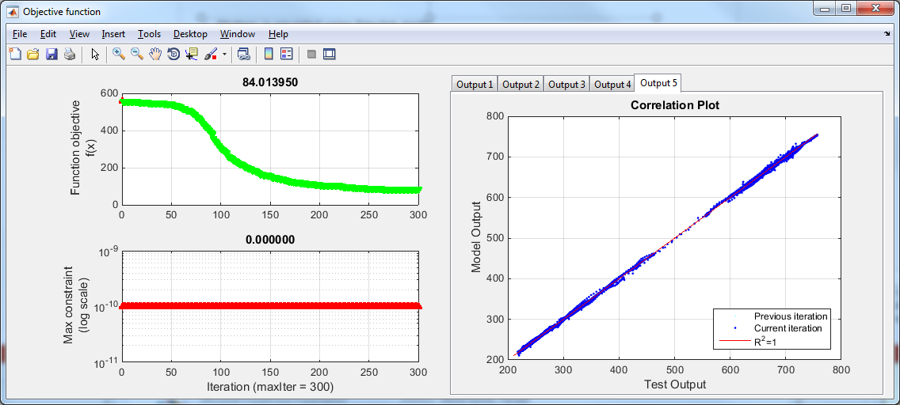
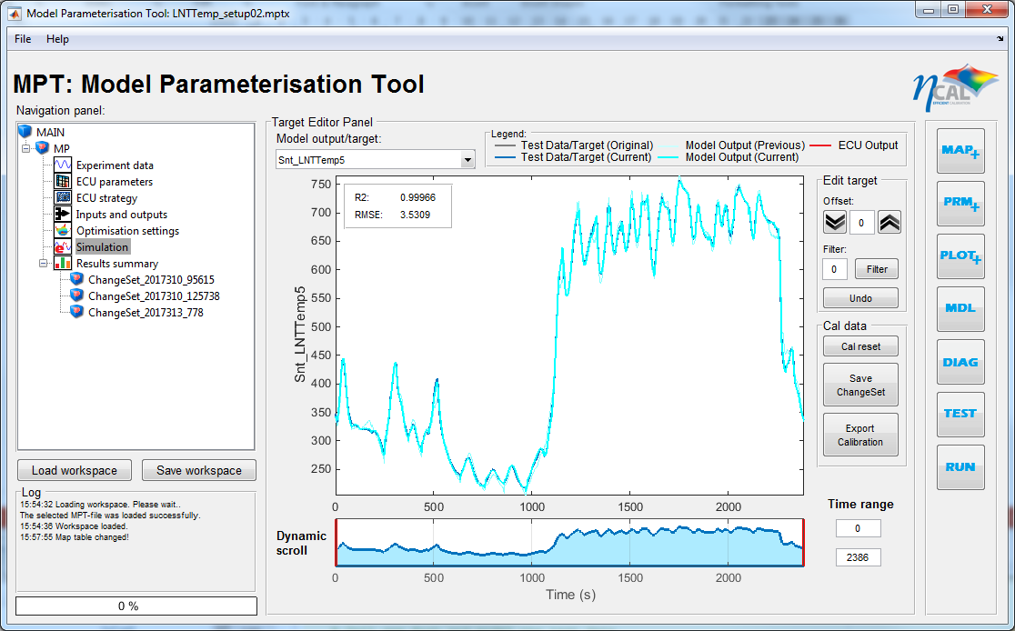
An after-treatment optimisation project
Filled up Lean NOx Trap (LNT) maps based on a recorded test cycle (time-series data)
Maps are initially filled with random values as a starting point
5 model temperature outputs simultaneously used to calibrate several maps
LNT model maps successfully calibrated using automatic map optimisation
Model output matches well to the recorded test cycle

Slide 21
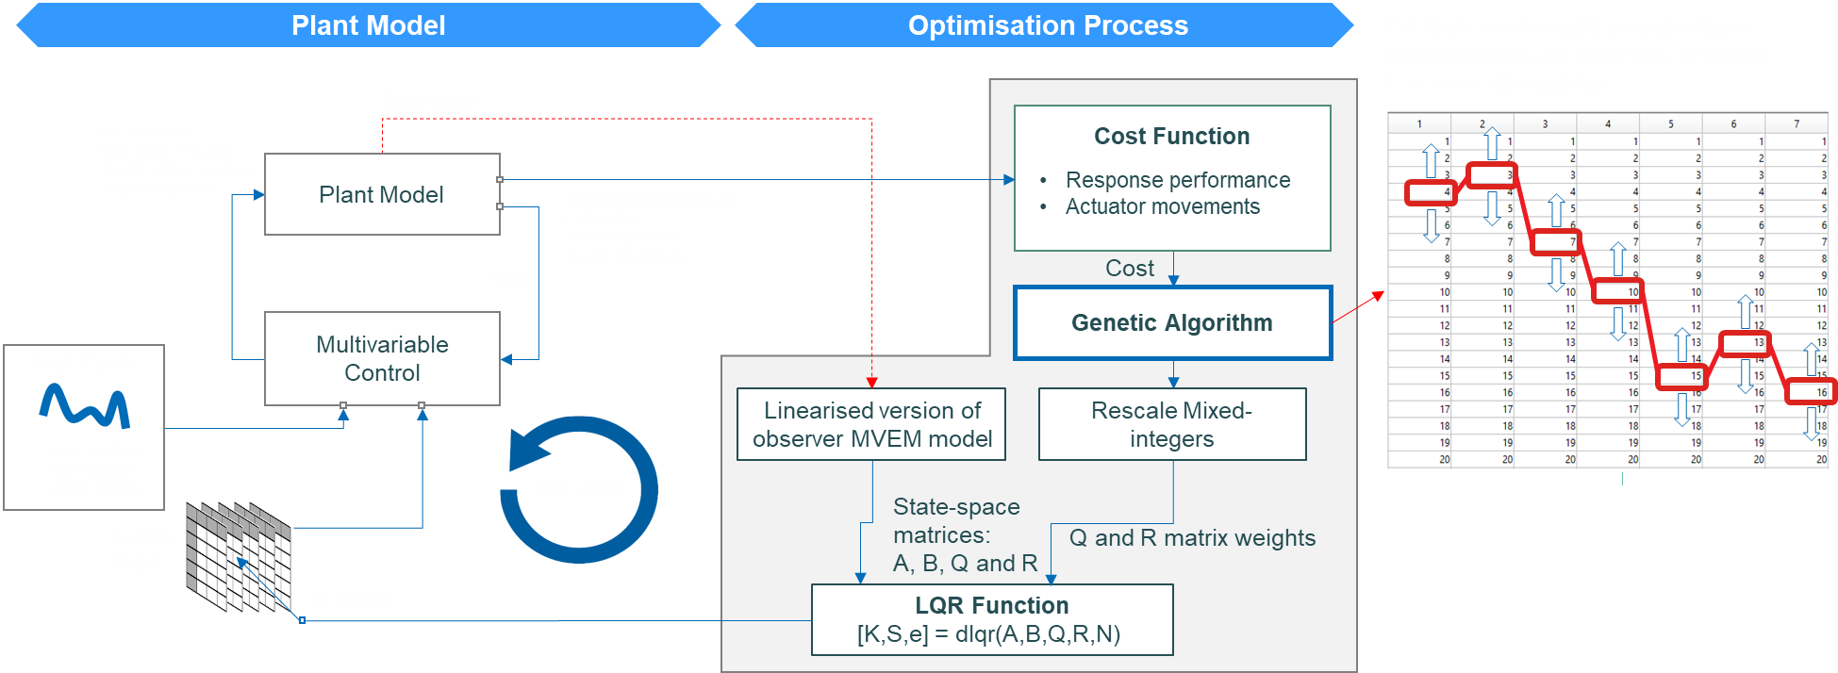
A client’s project to optimise LQR controller for heavy duty engines
LQR (Linear-quadratic regulator) controller can help to optimise the controller’s feedback gains and ensure overall stability of the controller but it needs design weights for the LQR which is not easy to get
Developed a meta-optimisation method to use genetic algorithm (GA) optimisation to optimise LQR optimisation weights. The Simulink model consists of a feedforward controller and a plant model.

Slide 22
lqr-gif.gif

Slide 23
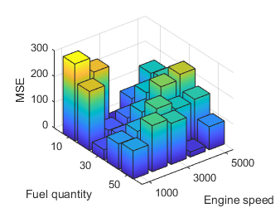


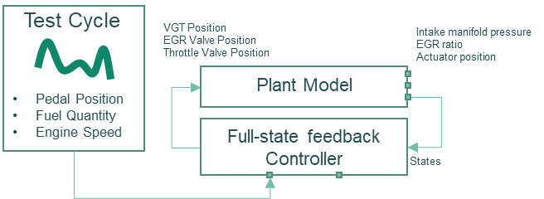
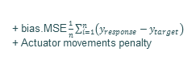
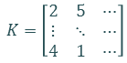
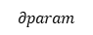
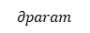
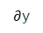
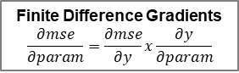
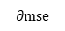
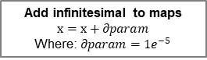
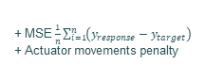

This is also for the same client but for a different plant model
Optimised a multivariable control gain map in Simulink using hybrid optimiser (GA + gradient method) optimisation when the system is cannot be linearised
It is a two-stage optimisation approach for more targeted optimisation
Stage 1: Optimise using GA for all operating points
Stage 2: Fine tune gain map for full test cycle
Load Steps
Test Cycle
VGT Position
EGR Valve Position
Throttle Valve Position
Intake manifold pressure
EGR ratio
Actuator position
VGT Position
EGR Valve Position
Throttle Valve Position
Intake manifold pressure
EGR ratio
Actuator position
Model compiled for processing
Using parallel computing
Plant Model
Target responses
Pedal Position
Fuel Quantity
Engine Speed
Plant Model
Target responses
Operating point selection
Pedal Position
Fuel Quantity
Engine Speed
Multivariable Control
Multivariable Control
States
States
Model evaluation
Gradient Descent Optimisation
Parallel Computing
Genetic Algorithm
Optimisation Process
Gains (integers)
[1,2,6]
Operating point selection
Add infinitesimal to maps
$$x=x+∂param$$
Where: $∂param=1e^{−5}$
Rescale
mixed-integers
Initial
start maps
(from GA)
K-gain maps
$$K=\left[\begin{matrix}2 & 5 & ⋯ \\ ⋮ & ⋱ & ⋯ \\ 4 & 1 & ⋯\end{matrix}\right]$$
K-gain maps
Gradients
Cost, ∑ (Error)
$$∂param$$
$$∂param$$
Maps Interpolation
Min Cost
Image of the model
GA Operators
Mutation
Min Cost
Function Objective
Crossover
Initial load step k-gain maps
+ MSE $\frac{1}{n}\sum_{i=1}^{n}{\left(y_{response}−y_{target}\right)}$
+ Actuator movements penalty
Target responses
Function Objective
Actual responses
Selection
Function Objective
+ bias.MSE $\frac{1}{n}\sum_{i=1}^{n}{\left(y_{response}−y_{target}\right)}$
+ Actuator movements penalty
Finite Difference Gradients
$$\frac{∂mse}{∂param}=\frac{∂mse}{∂y}x\frac{∂y}{∂param}$$
$$∂param$$
+ MSE $\frac{1}{n}\sum_{i=1}^{n}{\left(y_{response}−y_{target}\right)}$
+ Actuator movements penalty
$∂$y
Cost
$$∂mse$$
Interpolated initial k-gain maps

Slide 24
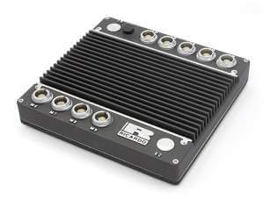


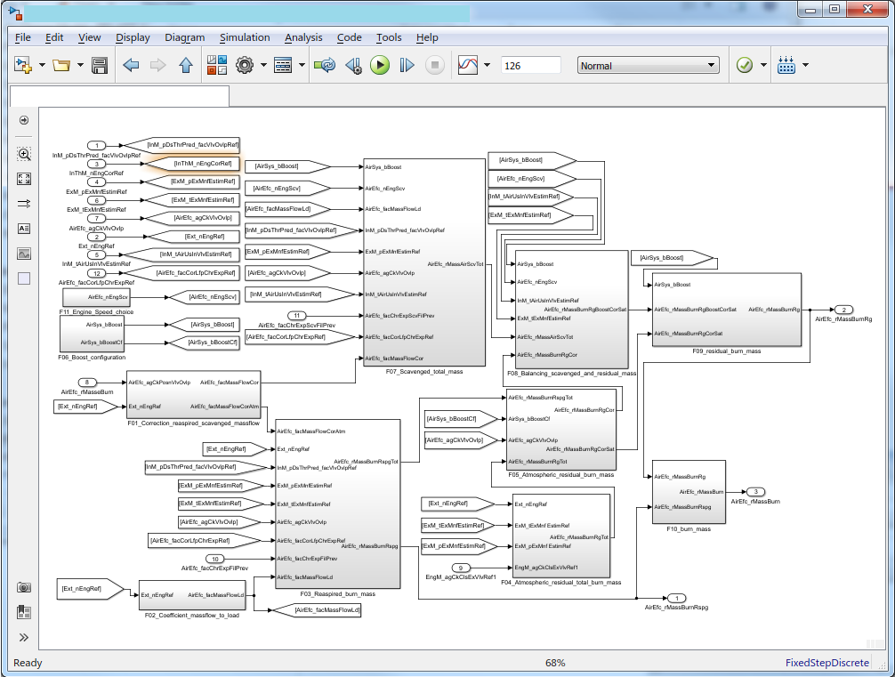
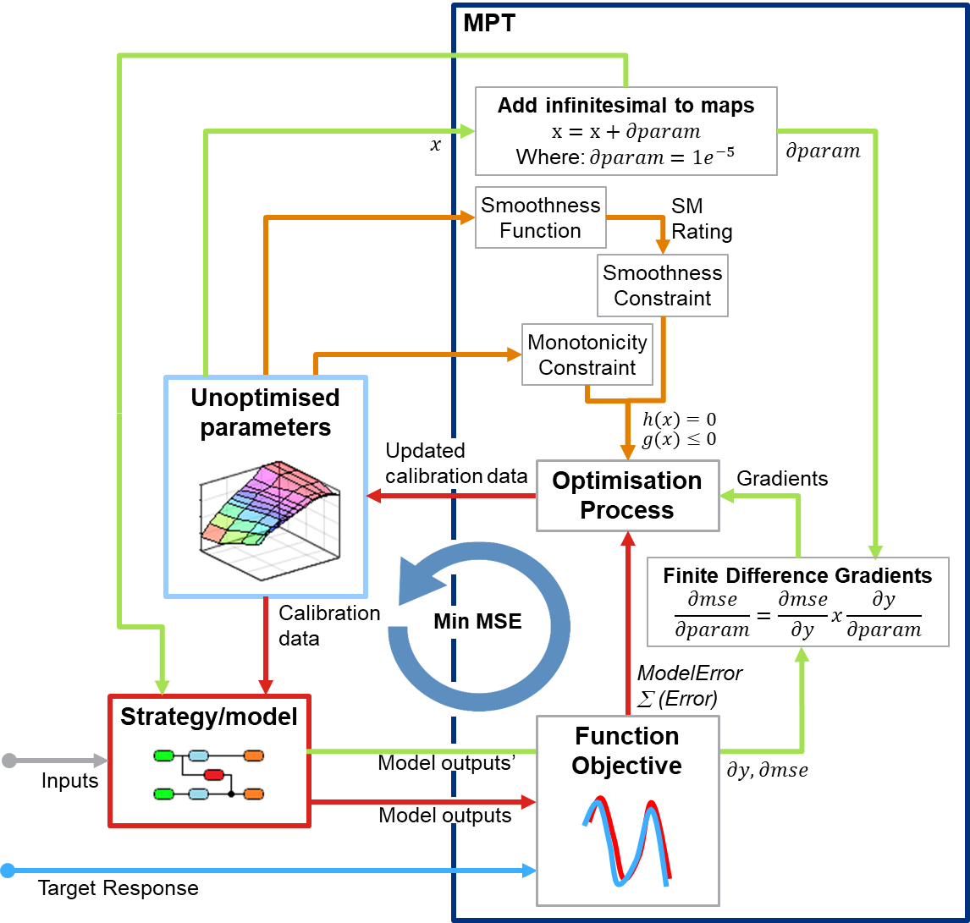
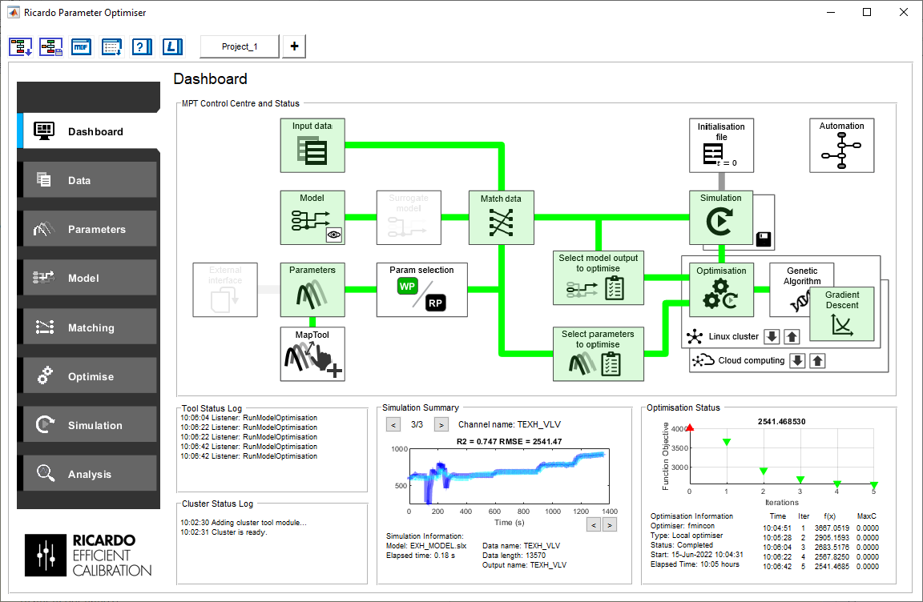



Model Parameterisation Tool (MPT) is a generic Matlab-based tool capable of emulating ECU strategy and populating ECU maps to match ECU model output to measured data.
The tool is now a standard Ricardo tool for emulating Simulink model and optimising Simulink models for control systems and ECU strategies.
MPT use advanced optimisation methods including hybrid optimisation and genetic algorithm.
Actual Control Unit
Optimised Calibration
DCM
Reconstructed Model
Optimisation Algorithm
Parameter Optimiser
Source of target response
Simulation
Vehicle
Recording

Slide 25
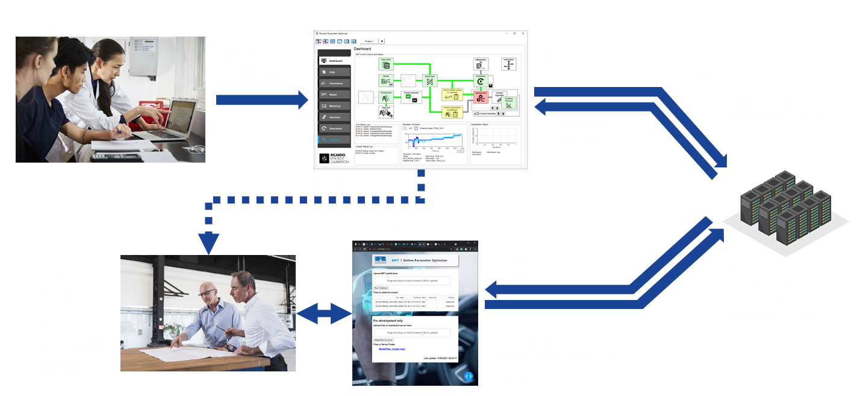

Slide 26
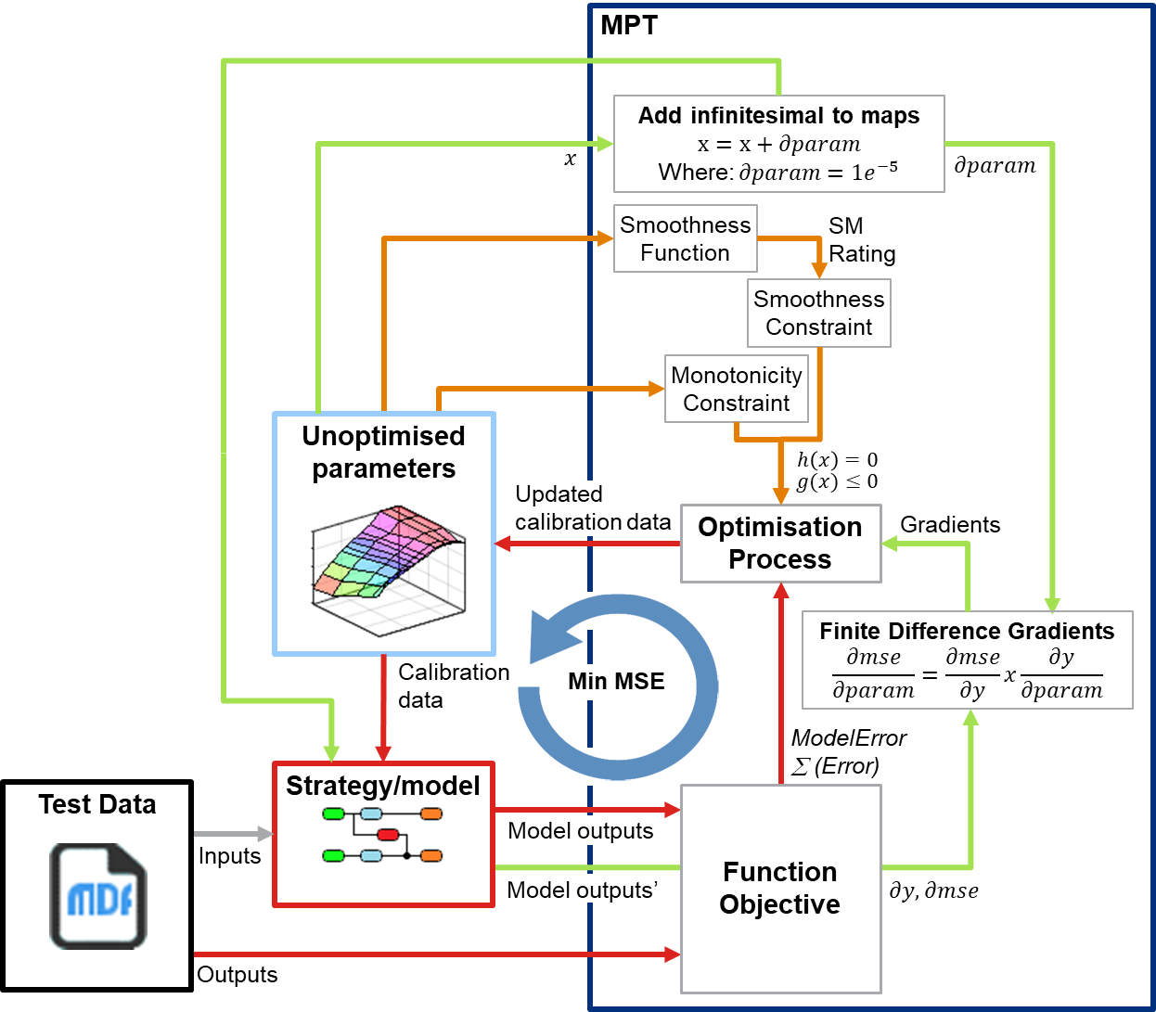
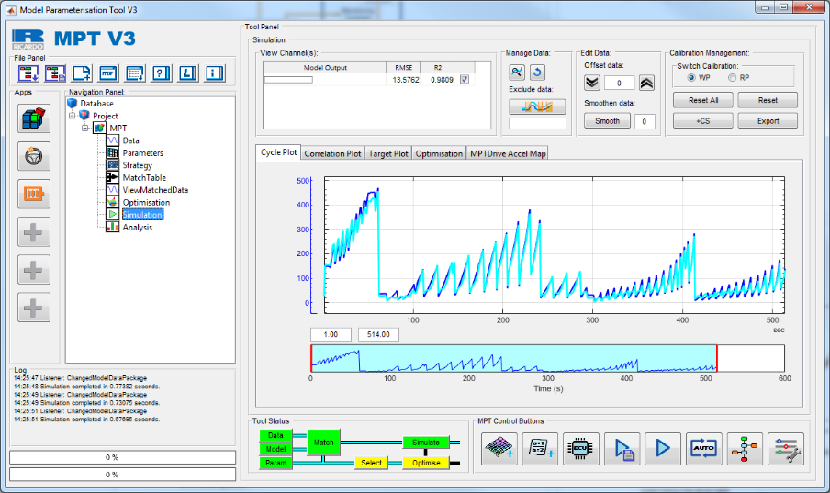
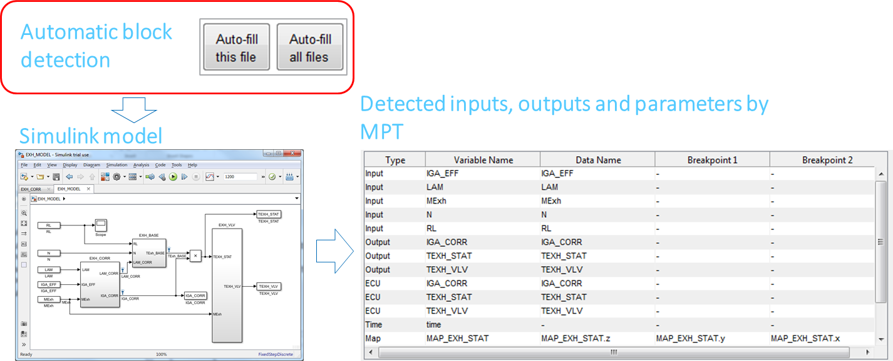
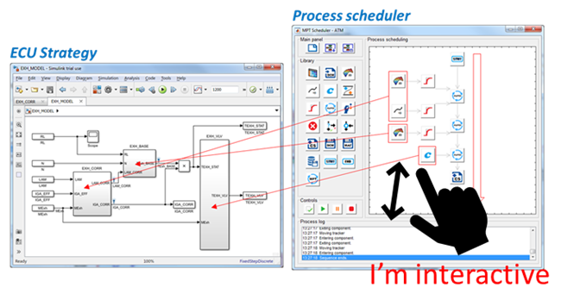
Simulink Surrogate Modelling
Replace time-consuming subsystems ML models to improve model run time
Simulink Optimisation
The calibration map optimizer is advanced and takes into account map smoothness, constraints, monotonicity constraints, finite difference gradients, and boundaries
Other MPT features
Automatic Simulink Block Detection
Fast model loading and set up
Interactive Process Scheduler
Drag and drop style process scheduling programming

Slide 27
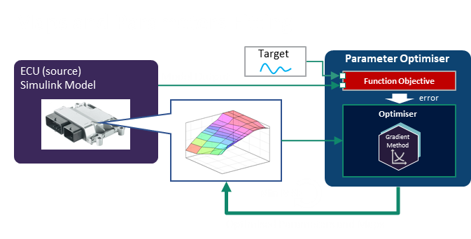
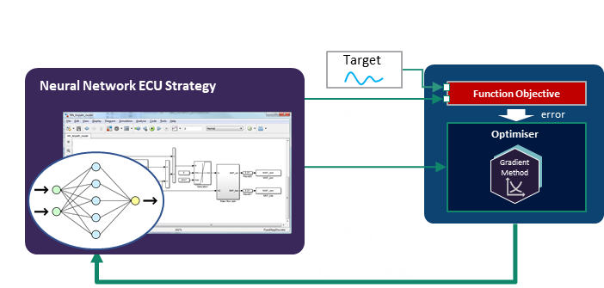
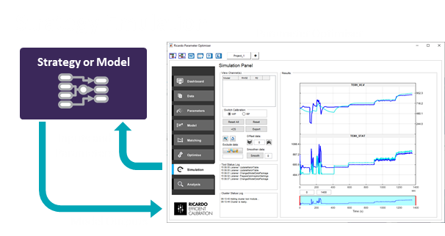


Slide 28


Optimising complex ECU strategies can take hours or days to complete. The optimisation process takes a long time to converge because the model is called thousands of times during gradient computation.
Found a way to reduce the simulation run-time using a machine learning technique
The outcome is an automatic process to replace parts of a Simulink model with a surrogate model with low run-time
The work was presented at AVL 8th International Symposium on Development Methodology, 2019
Application of surrogate model to MPT optimisation routine
Using ML model as surrogate model

Slide 29



For time in-variant strategies, DoE was used to generate the test points within the problem space. However, the number of points needed to characterise the strategy is not known in advance.
Therefore, a constructive modelling technique was used. This methodology uses a quasi-random DoE sequence which utilises progressive augmentation of a Sobol sequence for constructive model building.
The model generated shows quite a good correlation and is only missing noise in the data. The noise in the training data output is due to the logic, calculation and interpolations in the strategy. It is not coming from the inputs because the inputs are clean DoE data.
 | Without Model Reduction | With Model Reduction
Average run time (s) | 1.03 | 0.71 (-0.32s)
RMSE | 5.65 | 8.74 (+3.09)
R² | 0.997 | 0.993 (-0.004)

Slide 30


An R&D projects is to improve the accuracy when predicting engine emissions such as NOx and soot
Developed a time-series machine learning model algorithm from scratch to predict air-path dynamics for emissions prediction
The trained dynamic model can be used in our global optimisation or in Simulink s-function for predicting highly dynamic systems
Original Optimisation Routine
Modified Optimisation Routine
Maps
adjustment
Updated maps
Maps
adjustment
Updated maps
Cycle emission
prediction
Responses
Cycle emission
prediction
Responses
Boost and EGR prediction

Slide 31


The new approach is to combine a dynamic air system model with a static soot model to give more accurate transient soot prediction
This two-stage model approach is then adapted into a new calibration optimisation routine
The dynamic models are trained using dynamic-DoE (APRSS) and used to provide instantaneous boost and EGR predictions
APRSS is a sinusoidal type of APRBS
The dynamic model is an SPM model (a statistical machine learning model) or Volterra Series model wrapped around with NARX structure

Slide 32





The model algorithm is now a part of Ricardo’s Efficient Calibration model-based calibration software
The feature is being used for many automotive calibration development at Ricardo and by our client
Efficient Calibration Global Optimisation Tool
Efficient Calibration Dynamic Modelling Tool
Interactive tool
Can be used in Global Optimisation Tool
Trained Dynamic Model
Can be use for command line predictions
Use in scripts or Simulink s-functions for real-time predictions
The cyan line on the main plot is the selected outliers from correlation plot.
yt = spm_dynamic_predict(x,Md);

Slide 33






Supported a project that evaluate vehicle driving characteristics
Help the project team to process multiple DAT measurement files and generate the acceleration map
Since the task is time-consuming and can take about 2 weeks, a tool called MPT-Drive was created
It is a tool for processing vehicle data recording into acceleration map within minutes
The tool automatically detect manoeuvres, run data segmentation, alignment and surface fitting to get an acceleration map that defines a vehicle brand character
Automatic Tip-In Detection
Generate Acceleration Map
Automatic Excel and PowerPoint
Report Generator
mdf
mdf
mdf
mdf
mdf
mdf

Slide 34


MPT-DRIVE and MPT can work together within the same tool to optimise a pedal map using a virtual vehicle model (VSIM)
The process takes advantage of MPT model setup and optimiser to optimise a pedal map by comparing the VSIM accel map to an actual vehicle accel map
MPT calculate the difference between the acceleration maps and make appropriate changes to the pedal map in VSIM to make it closer to the reference vehicle’s accel map
At the end of the optimisation, the vehicle model (model tuned to represent an actual vehicle) will have the same driving characteristics as the reference vehicle
MPT
MPT with MPT-Drive App Integration
Min MSE
Model Error
∑(error)

Slide 35






Ricardo Trace Project is a project to convert 1000s of images into working Simulink models in a relatively short time. They are control strategies printed in ECU documentation and Bosch Ascet diagrams. Led a team of calibration engineers and software developers to develop a tool and use it for the project using Agile methodologies.
ECU Strategy Diagrams
What did we achieve?
Developed custom Bosch Ascet-like Simulink library that is almost identical to the real one
Developed a tool that uses ML, AI and image processing to extract information from the document and automatically convert them into Simulink models
Generated 1000+ models and subsystems within three months together with model validation using our own Model Parameterisation Tool
Generated Simulink Model
Ricardo Trace
* Showing old Trace outputs due to project confidentiality
Simulink Ascet Blocks

Slide 36


Trace can automatically convert strategy images from a PDF document into Simulink models
By combining a deep learning model, image processing techniques, a robust AI (Artificial Intelligence) line tracking method and OCR (Optical Character Recognition) the tool can identify blocks in images and reconstruct the Simulink models programmatically
Partially eliminating human labour in recreating a strategy
The Trace tool was able to read images and reconstruct a sample model in 116 seconds.
In comparison, a human developer needed 685 seconds to do the same task
The project won Ricardo Phil Hore Engineering Award for invention of the tool
I’m interactive

Slide 37




Image processing techniques and to find block boundaries
Image morphological operations (skeleton, opening, bridge, thicken)
Morphological structuring element
Region filling, image erode
AI Line tracking agents to find block connections
Arrows detection using 2-D correlation and region properties
Deep Neural Network to classify images according to their classes

Slide 38


Slide 39
Ricardo Trace

Slide 40


Often, surfaces need to be generated from a set of drive cycles and they are not continuous enough to be modelled.
For instance, an engineer is required to estimate the surface profile for three drive cycles and normal surface fit will not handle this or produce the wrong surface
So, a two-stage fitting process is needed for local and global points
The result is a much smoother surface usable for calibration purposes

Slide 41













An SAE paper was written to present the working principle of calibrating a PI controller for a fuel transport delay plant using the Model-based Calibration (MBC) method
The test sequences are designed within the constraint to prevent high controller instability and integrator windup. The constraints can be determined using a survey test to find the corner limits of the constraint design.
The settling time and oscillation index from FFT were modelled using the Model-based calibration toolbox using an RBF model
The outcome of the automatic calibration process is a series of optimized gain scheduled tables for the fuel PI controller

Slide 42


A research about constructive model building for model-based calibration process to help reduce the number of DoE test points and shorten the calibration development time
When building statistical models for the calibration process, it is often necessary to guess the model size, and there is no clear rule on how to select the number of DoE points.
A constructive model building eliminates the need to guess the test points
Model building can stop when model accuracy is good enough
This method was used in my PhD for real-time engine model building
Standard modeling process
Constructive modeling process
A constructive model building is a process of developing a model at the end of each test session. At the end of each test session, the test results are analyzed and a model is promptly developed. Once, the developed model is good enough for repeatability and prediction, the test can be stopped without having to complete all test sequences
The outcome of the engine test is only known when the modeling process is complete. The weakness of this approach is that the DOE test sequences need to be completely tested before modeling the system due to the interactions existed between each test sequences.

Slide 43








Continental 16-bit ECU to 32-bit torque-based ECU Conversion for 1.6L engine
In-charged base dyno calibration
Air-path calibration
Exhaust temperature model
Base ignition and fuel map calibration
Attended knock control calibration at Continental, Toulouse
In-charged of ECU related activities, wiring troubleshooting ECU equipment training
Used ETAS INCA V5/6 and ETAS 590 series ECU interface module at the test cell
Attended ETAS INCA training at Lotus Engineering, Norwich
Work experience at Proton Malaysia and Ottoworks Engineering
Wankel engine installation and base calibration at engine test cell for prototype Proton hybrid vehicle project
Supervised engine installation
Generated start file and performed base calibration activities
In-charged of cylinder head testing using SuperFlow SF600
Supplied Motec M800 ECU to a Malaysian University
Installation of ECU short wiring harness in a Proton Persona vehicle
Generated ECU start file from scratch

Slide 44
Data Science Projects

Slide 45


When fleet data is limited, we generated an artificial fleet to start creating initial ML models
We use Monte-Carlo simulation to generate the fleet data and use realistic data distribution so that it is representative of the actual fleet
This process can be used for:
Warmup the ML models Once fleet data is available, the ML models or classifiers can be updated so that they will be more accurate
We also use a damage model within Monte-carlo Simulation to degrade the selected component until EOL
Generate a new test cycle for MiL application

Slide 46

A project to investigate application of autoencoder to detect faults or anomalies in systems such as sensor drifts, faulty subsystems, component failure, etc.
Situation and Objective
Overview and Approach
During the early production stage, it is normal not having enough faulty components
This will make it difficult to train anomaly detection without having enough actual anomalies in the training data
Autoencoder is an unsupervised outlier detection that is suitable for one-class learning (i.e normal data)
Autoencoder is a type of neural network for learning data in an unsupervised manner
Autoencoders create a replica dataset by forecasting on a specific time window
If the replica is different from the original then it is assumed as anomalous.
As the system measurements drift into abnormal operation and it crosses a set threshold, the operation is going to be faulty
Results and Benefits
Autoencoder is easy to train and is a lightweight neural network with a single hidden layer but it can be configured for more complex problems with more hidden layers
The accuracy depends on error thresholds
Sensor drift and replicated signal difference causing high MSE

Slide 47










A calibration and controls department project to investigate the benefits of cloud computing to reduce the vehicle development process
We performed various activities on the cloud such as optimisation, fleet processing and modelling
One of my tasks is to investigate how we can create a machine learning models from vehicle data and detect anomalies in real-time within the cloud platform
AWS S3 bucket is an object storage service and is a type of data lake
SageMaker is a machine learning platform to create and train models, handle deployment, data processing at scale, prepare automated workflow (CI/CD), and many more
An anomaly detection model was trained in SageMaker using Jupyter Notebook and SageMaker Scikit-learn estimator
Models are deployed as “Endpoints” for real-time or batch inferences
S3 Bucket
SageMaker
Client or user interact with a dashboard hosted in EC2 instance (a virtual server in AWS Cloud) with a flask and Python backend
AWS API Gateway is the front door to the platform
AWS Lambda is the event-drive, serverless platform that run codes
SageMaker Notebook
Model training script
Model training script
1.Initialisation
Prepare data
Vehicle Data
Model Artifacts
Training Data
2. Model Estimator
Feature engineering
Query
Fitting process
Data
3. Fitting process
Predictor Object
4. Deploy
Authentication
Predictor Object
5. Create Endpoint
Lambda sends payload (input data) to SageMaker Endpoint for inference and sends back the results to the dashboard
Data
AWS IAM
Invoke Endpoint + Payload
EC2
Trigger lambda function
POST request
GET
Response
Client
Front end
Response
Inference results
SageMaker Endpoint
Backend

Slide 48




ML Test Platform
The AWS services, SageMaker Endpoint, Lambda and API Gateway are linked to providing seamless integration
Inferences can be requested from a dashboard to check if the real-time data contains anomalies
Training Data (normal)
POST/GET
Local Outlier Factor (LOF)
A unsupervised anomaly detection algorithm
Test Data (with anomalies)
Vehicle Data
SageMaker Endpoint

Slide 49



















Connected BMS is a project to explore and develop a platform to use digital twin, Monte-Carlo Simulation, machine learning, database and dashboarding
The main purpose is to improve a fleet of electric vehicles’ life by providing targeted BMS updates
My tasks mainly on planning the Monte-Carlo Simulation and supporting the machine learning tasks
Vehicle Fleet
Fleet Data + Service Records
Data Over The Air (DOTA) test platform allows to assess, evaluate and compare different data exchange techniques from BMS to cloud
BMS Updates
Fleet health monitoring
Fleet
SoH Data
Current state of health and predicted lifetime
New BMS Parameters
Database
Machine Learning Pipeline
SoC
Estimation
Optimisation
Power Availability Calibration
RUL, SoH
Minimum
Capacity
Data
Processing
Anomalies,
Failure
classification
Remaining
Life
Fleet Data
Fleet Digital Twin
Service Records
High Fidelity Model
Fleet prognostics
Digital Twin
SoH Prediction
Customer satisfaction
Database can be on a cloud services such as AWS or Azure, or local storage
Fleet Digital Twin
Model Training Algorithm
High Fidelity Model
Initial Training
Service
Records
List of vehicles at risk
Minimum
Capacity
Current prediction can be compared with actual fleet data interval service records for model retraining
Extended
Life
Software Over The Air (SOTA) test platform for assessing software & calibration update strategies
Potential state of health and predicted lifetime scenarios

Slide 50


Some of my outcomes from the project:
Fast prototype platform developed in one week to test data transmission from a simulation fleet to our PostgreSQL and connected to a simple dashboard
Platforms or packages used:
Fleet simulation – Python script with vehicle and fleet classes to simulate battery degradation (SoH)
2) Multi-processing scripts in python to run simultaneously at different rates (to simulate real data transmission frequency)
3) A ‘Dash’ dashboard to view fleet performance and health
Final dashboard connected to our machine learning platform and PotgreSQL database. It is using a ‘Dash’ web framework that runs on Python. Displaying fleet performance and vehicle location using MapBox for real-time vehicle tracking.

Slide 51
Some of my outcomes from the project:
I have developed a prototype ‘Decision Engine’ using deep reinforcement learning to proof that prescriptive analytics can help to further improve fleet health using environmental factors. It took me two-weeks to develop:
The agent was trained using deep RL
Sends targeted BMS monthly updates by prioritising su- fleets depending on congestion and ambient temperatures
An interactive dashboard to run the simulation, train the RL and compare the results
rl.gif

Slide 52
Monte-Carlo Simulation
Planned Monte-Carlo simulation factors
My plan was used by the simulation team member to construct the vehicle fleet
MQTT Protocol
Used MQTT (An IoT protocol) to send and receive data using local broker and Azure IoT hub
Simulink to FMU
Converted Simulink models to FMU so that we can run on Python.
Other experiences gained from the project
Project management
Helped project manager to set machine learning tasks
Machine Learning Model
Helped to create initial ML model for the battery degradation model using real battery data
Database
Accessing PostgreSQL, view data and write simple scripts to get data
Webinar
Presented the project webinar with project director and manager.

Slide 53



A client requested to run machine learning models in Excel to predict engine emissions
Developed a converter to convert Ricardo SPM algorithms (an ML model) and parameters from Matlab into Excel BAS modules
The BAS modules allow Excel to run SPM models without any special software or toolboxes
This SPM feature is simple but it shows the possibility to run complex algorithms work in a primitive environment that is accessible to others
Modelling Tool
Automatic VBA BAS module and Excel sheet generation from Efficient Calibration Modelling Tool
Engine response predictions in Excel
SPM Model in Excel VBA Module
Users can have this excel with embedded ML models. No other tools are required to run the response prediction.
Predictors
Responses
Optimised ML code generation in VBA to prevent memory allocation failure

Slide 54



A project to process all historical engine data and create a NOx model to predict emissions for new engines
A custom regression tool was developed to help make models faster
The tool was used by the engine performance engineers to:
Predict emissions (i.e. NOx) for different engine configurations
Optimise BSFC/NOx trade-off to find the optimal EGR level and injection timing
Compile model into DLLs and used in WAVE-RT
NOx model prediction quality using Gaussian Process Model
The risk factor can be shown to determine the risk of prediction point

Slide 55





Models can be used in an Excel file or Ricardo Wave-RT
ML Model
Model Types:
Gaussian Process Models
Support Vector Machine
Tree models
Lots of engine data from database
Panel to sort and filter modelling data
Various model types are available and can be easily compared
View model surfaces and risk factors
Engineers can predict
new engine emissions in
Excel using embedded
ML model
Inputs to the Model
Emissions
Prediction
Compiled models and dll
Emissions
Prediction
R-Machine Compiler for compiling models into Excel

Slide 56


A tool for reverse engineering images into numerical data
Used for converting images of geographical maps or contour plots back into data which engineers can use for processing
Using ML techniques to do the segmentation
The tool can help to reduce hours or days of conversion work in just a few minutes
It helped to improve work efficiency and prevent delays in the manual process which can be a painstaking process

Slide 57


An MDF tool was developed to read vehicle measurement files in MDF format, write data to MDF, append excel data to existing MDF files and align emissions data to measurements file.

Slide 58




Developed the algorithm to append data to a DAT file and is regularly being used by calibration engineers
It managed to reduce customer complains of having two unaligned recording files
* The append process is fast because it only append new data group to an existing binary file and just changing the next data group position to make the new data group visible to MDF file reader.
Vehicle Recording
3. Add next DG (data group) position at the last DG (data group)
Emissions Recording
2. Append new data group at the end of the binary DAT file
1. Pre-allocate empty spaces in the binary file

Slide 59
Misc. Tools
And Hobby Project

Slide 60



Created a script to convert optimisation results into a single HTML file
Lightweight HTML file with a low file size
Can interactive plots of time-series data, correlation plots, map surfaces or bar charts.
Written in JavaScript and is compatible with any browser and devices
Dynamic scroll bar

Slide 61
Modified modelling support feature to help calibration and control engineers quickly modify blocks in Simulink via a new user menu
Integrated the tool into our new MPT or Parameter Optimiser
Features such as:
Add inputs to subsystems
Add source blocks to selected blocks
Get signal list

Slide 62



A hobby project in 2018 to explore the application of GA (Genetic Algorithm) to a motorsports problem
Challenges:
Only three power units are allowed for the whole 2018 season
Some of the power units can come from the previous season
They have different power outputs and RUL (Remaining Useful Life)
Objective:
Make a strategy of which power unit to use for each race
Support strategy engineer decision making
Optimisation problem:
Choose a power unit for each race
Maximise power output for the whole reason
No engine failure until the end of the season (constraints on the RUL)
2018 Race Calendar
No
Date
Race Track
Power Unit
To use
?

Slide 63


Assuming only 3 power units were allocated for each season and the Power Unit (PU) from the previous season can be used
An optimiser was developed to make a selection of PU to use at each race which can maximise power while maintaining zero failures until the end of the season
An artificial damage model was developed to test the optimisation algorithm. In a real application, the damage model can come from a digital twin
Damage Model
Power Loss due to temperature and mileage
GA fills in power units
Optimiser
2018 Track info with race
distance and average ambient
temperature
Allocation for each track in the year
PowerUnit ID
1 | 1 | 3 | 2 | 2 | 1 | 3 | 3 | 1 | 2 | 1 | 1

Slide 64
The optimiser allocated the three PU for each race which maximises engine power while keeping RUL more than 0%
10 random allocations are generated and the RUL and power reduction are determined. This is then compared to the optimised allocation.
This exercise is only to test how GA would be beneficial for discrete optimisation problems or selection problems
No | Date | Track | ICE | RUL | Power left
1 | 25-Mar | AUSTRALIAN | 1 | 69 | 421
2 | 08-Apr | BAHRAIN | 3 | 85 | 440
3 | 15-Apr | CHINESE | 1 | 57 | 419
4 | 29-Apr | AZERBAIJAN | 3 | 73 | 439
5 | 13-May | ESPAÑA | 3 | 61 | 435
6 | 27-May | MONACO | 2 | 61 | 397
7 | 10-Jun | CANADA | 3 | 50 | 433
8 | 24-Jun | FRANCE | 3 | 39 | 427
9 | 01-Jul | ÖSTERREICH | 3 | 28 | 424
10 | 08-Jul | BRITISH | 1 | 45 | 416
11 | 22-Jul | DEUTSCHLAND | 1 | 35 | 411
12 | 29-Jul | NAGYDÍJ | 1 | 24 | 406
13 | 26-Aug | BELGIAN | 2 | 49 | 395
14 | 02-Sep | DITALIA | 3 | 17 | 418
15 | 16-Sep | MARINABAY | 2 | 40 | 377
16 | 30-Sep | RUSSIAN | 2 | 29 | 371
17 | 07-Oct | JAPANESE | 1 | 13 | 403
18 | 21-Oct | UNITEDSTATES | 2 | 19 | 364
19 | 28-Oct | DEMÉXICO | 1 | 1 | 400
20 | 11-Nov | BRASIL | 2 | 9 | 357
21 | 25-Nov | ABUDHABI | 3 | 7 | 409

Slide 65

A project to investigate behaviour of SVM (Support Vector Machine) and T-SVM (Transductive Support Vector Machine) classification algorithm and how we can use it classify better with less labelled data
Literature or mathematical expressions on SVM can be difficult for most people understand
An interactive tool can help people to understand more about SVMs
Serves as a testing ground to investigate the behaviour of SVM decision boundary with added anomalies
The study is then used as the basis to create future anomaly detection algorithm
Real-time decision boundary update after user drag/move data points

Slide 66

A simple fleet simulator to run several vehicles on a designed road layout
The tool was built from scratch written without using any toolboxes
The tools were initially developed to simulate vehicle fleet and crash avoidance algorithm
Features:
Interactively design road layout
Create custom vehicle objects and characteristics
Run vehicle objects on the layout
Basic PID to control vehicle motion
Interactive track designer on the plot

Slide 67




Medium to big-sized tools are structured in an MVC (Model-View-Controller) software design pattern so that it is more organised and allow future expandability
Developed HMVC (Hierarchical MVC) in Matlab as an extension of the MVC framework to support larger tool
For a tool to expand with additional apps or add-ins, it needs to have an expandable framework
One method is the HMVC framework which contains multiple MVCs or Apps
View
Main Tool
Controller
Model
objTool.Gui.ToolPanel
View
RDrive
View
Controller
Model
Batt.
Controller
Model
View
MPT
Controller
Model
Battery App Panels
MPT App Panels
View
Map
Tool
Parent Panel,
Obj.Gui.Figure = objTool.Gui.ToolPanel
Controller
Model
Parent Panel,
Obj.Gui.Figure = objTool.Gui.ToolPanel

Slide 68



Slide 69



Slide 70



This is a project for HMC (Hyundai Motor Company) to develop an AI motor NVH optimisation platform
My role is lead AI engineer managing and developing AI algorithms and dashboard development
Completed in 3 months and the AI decision engine can generate 250 new motor designs in 5 seconds
Please contact Farraen for a copy of SAE paper

